Slide 1

Website Development: Lesson 7
Facilitated by: Titus Kariuki
Notes:
Web development kahoot

Slide 2
Agenda
1. Ice breaker
2. Recap
3. Organizing Information
-Q&A
4. Lesson 3 Challenge 3 - Dinner Table
-Q&A
5. Project 2 - Recipe Book

Slide 3

Ice Breaker
Favorite thing you cook?

Slide 4

Recap
Links
Difference between relative and absolute links?
How to check if your link is functional?
What is the “target” attribute used for when defining links?
Jumping
What is jumping? What is it used for?
What is a hyperlink?

Slide 5
Tables
What is a good way to separate information?
Using tables
Redesigning lists

Slide 6
Tables
Which looks prettier?
Company:
Microsoft
Employee Name:
Billy Bob
Years of experience:
1
Company name 2:
Amazon
Employee Name:
Joel Sum
Years of experience:
96
Company Name | Employee Name | Years of Experience
Microsoft | Billy Bob | 1
Amazon | Joel Sum | 96

Slide 7
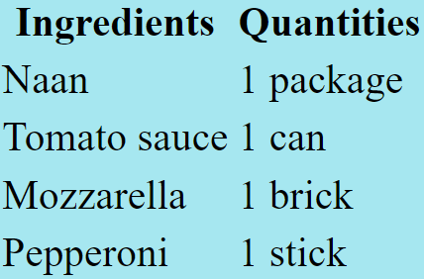
Tables
The <table> tag allows you to sort information nicely.
It won’t create a nice table…yet.
Instead, table tags change how the information looks.

Slide 8
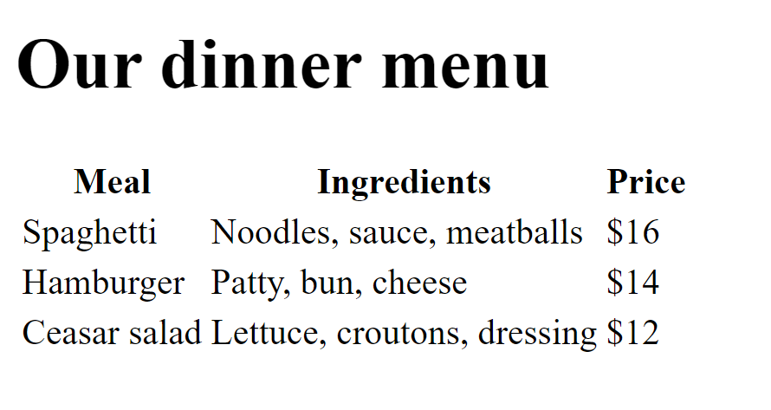
Tables
Table basics:
Declare a table you want to create
Define the header cells
Create Rows
Fill in rows

Slide 9
Tables
What it does | Opening Tag | Closing Tag
Opens the table | <table> | </table>
Table header content | <thead> | </thead>
Defines a table row | <tr> | </tr>
Defines the table data/cell | <td> | </td>
Creates the table caption | <caption> | </caption>
Creates the table body | <tbody> | </tbody>
Creates the table footer | <tfoot> | </tfoot>

Slide 10
Tables
The table should look nay this…
<html> —----------------------------Open your html webpage
<body> —----------------------------Open your body
<table>-----------------------------Open your table
<tr>—-----------------------------Open your table row. You will open many.
<th>Heading 1</th>--------------Opening and closing the headers. Put
<th>Heading 2</th>-------------- your headers in between.
<th>Heading 3</th>--------------
</tr>-----------------------------Close your table row.
</table>----------------------------Close your table
</body>-----------------------------Close your body
</html>-----------------------------Close your html webpage

Slide 11
Tables
Inside your tables, do this…
<table>-----------------------------Open your table
<tr>—-----------------------------Open one row.
<th>Heading 1</th>--------------Opening and closing the headers. Put
<th>Heading 2</th>-------------- your headers in between.
<th>Heading 3</th>--------------
</tr>-----------------------------Close one row.
<tr>—-----------------------------Open another row.
<td>Data 1</th>-----------------Opening and closing your data, then put
<td>Data 2</th>----------------- your data inside.
<td>Data 3</th>-----------------
</tr>-----------------------------Close one row.
</table>----------------------------Close your table

Slide 12
Tables
Put as much data as you want.
<tr>—-----------------------------Open a row.
<td>Data 1</th>-----------------Opening and closing your data, then put
<td>Data 2</th>----------------- your data inside.
<td>Data 3</th>-----------------
</tr>-----------------------------Close the row.
<tr>—-----------------------------Open another row.
<td>Data 4</th>-----------------
<td>Data 5</th>-----------------YOU CAN PUT AS MUCH DATA AS YOU WANT.
<td>Data 6</th>----------------- JUST KEEP OPENING THE TABLE ROWS.
</tr>-----------------------------Close the other row.
Repeat for however long you like. :)

Slide 13
Tables
Your overall table will look like this (Zoom in)
<html>
<body> <table>
<tr>
<th>Heading 1</th>
<th>Heading 2</th>
<th>Heading 3</th>
</tr>
<tr>
<td>Data 1</th>
<td>Data 2</th>
<td>Data 3</th>
</tr>
<tr>
<td>Data 4</th>
<td>Data 5</th>
<td>Data 6</th>
</tr>
</table>
</body>
</html>
(Zoom in/out…
CTRL ALT +/- )
{COMMAND ALT +/-}
Notes:
If this slide is still too small or unviewable, then check the “Lesson 7 Sample Code” document in the drive for a zoomable code.

Slide 14

Questions?

Slide 15
Practice: Cartoon Table
Make a table of your favorite cartoons.
Refer to Slide 13 for the table structure.

Slide 16
Practice: Cartoon Table
It should look something like this…
Cartoon Network | Nickelodeon | Boomerang
Ben 10 | iCarly | Tom & Jerry
Bakugan Battle Brawlers | Spongebob Squarepants | Topcat
Teen Titans Go! | The Patrick Star Show | Duck Dodgers
Total Drama Island | Sam and Cat | Scooby Doo
Notes:
Refer to the “Lesson 7 Sample Code” doc in the drive for the code.

Slide 17

Project 2: Recipe Book
You are now equipped with the tools to make a nice recipe book!
Pick your favorite dish and create a detailed reciping including, but not limited to:
Pictures
Hyperlinks
Lists
Tables
CSS pizazz
Headers
Feel free to check out resources and try to add elements not talked about in class. REACH OUT WITH QUESTIONS!

